Slide 1
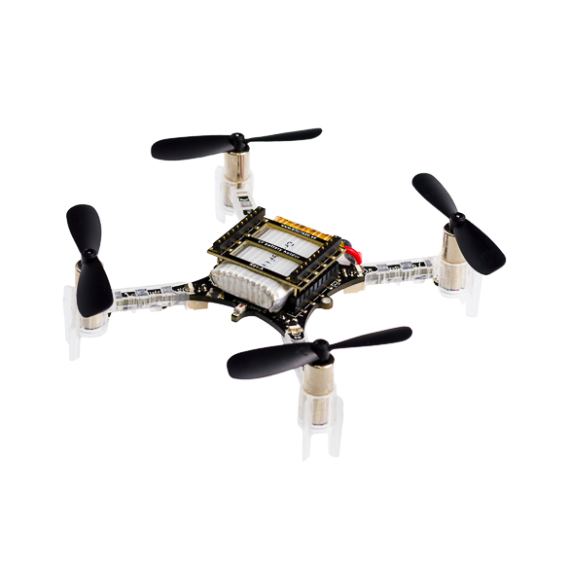
Planning and Control of a Quadrotor
EN530.678.S2021
Spring 2021
Jiahe Xu
Ray Zhang

Slide 2
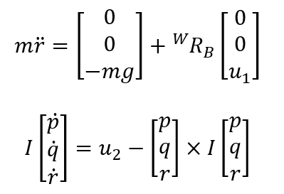
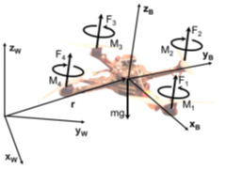
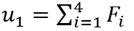
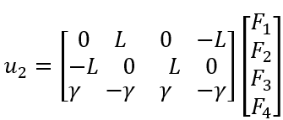
Quadrotor Model
Fi are forces produced by rotors
We directly control u1 and u2
Q

Slide 3
Our method
read the map, build the environment with small cubes
find an initial path using shortest path algorithm
use CEM method finding a better path
apply minimum jerk polynomial method producing smooth trajectory
Q

Slide 4
We used minimum jerk segments methods to generate the trajectory.
n segments
5th order polynomials
3rd order derivatives ( minimum jerk)
Q

Slide 5
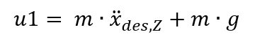
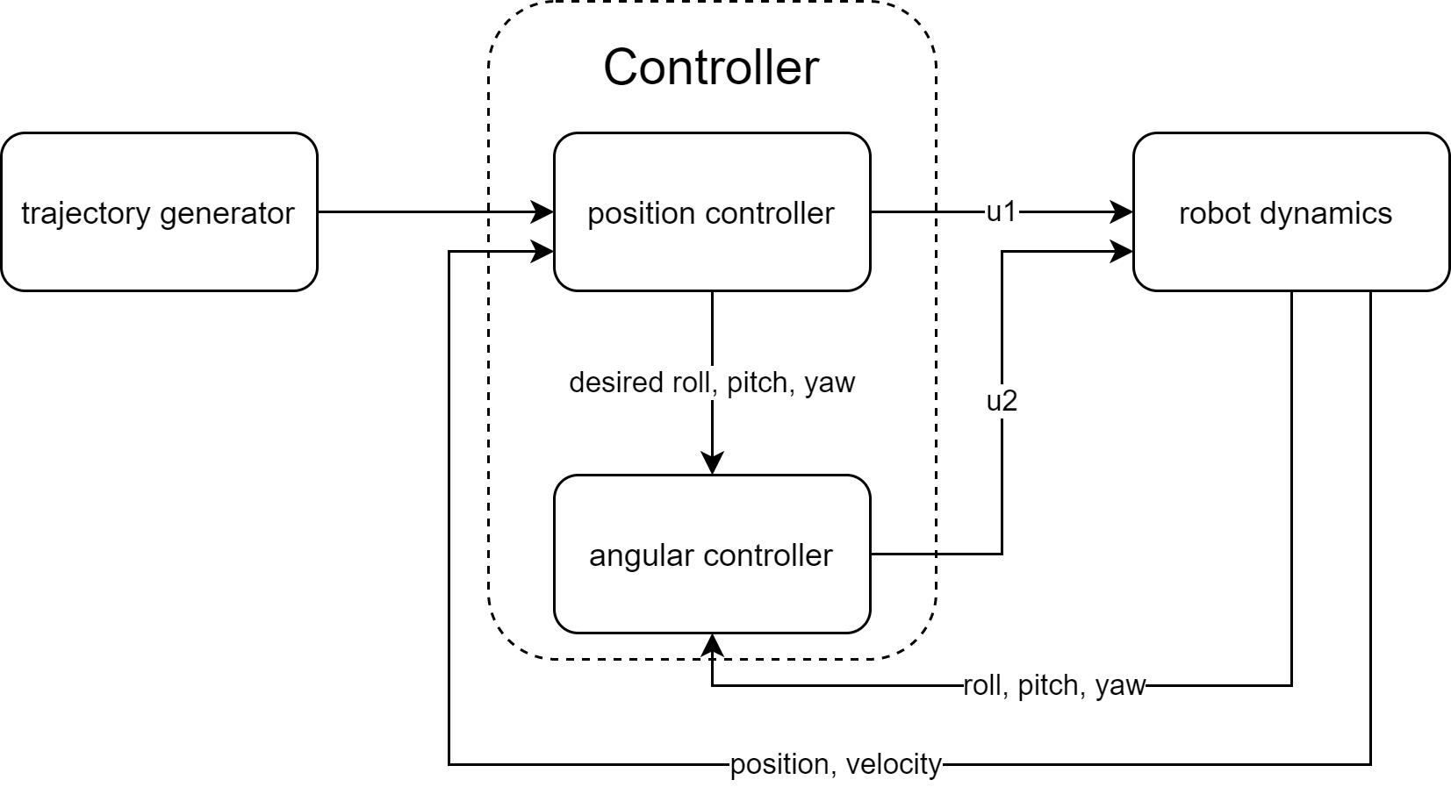
We used linear backstepping control to control the quadrotor to follow the trajectory.
total motor thrust
Q
moment about the center

Slide 6
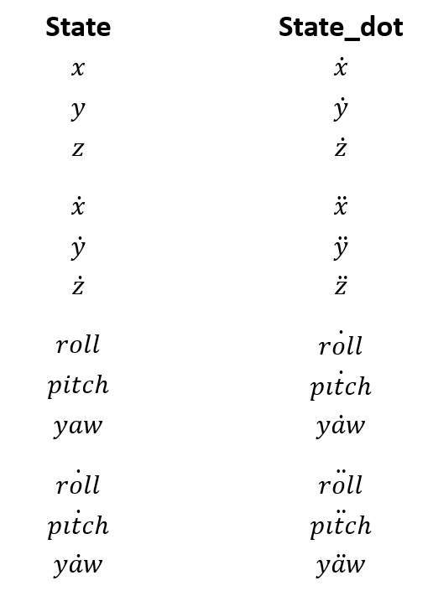
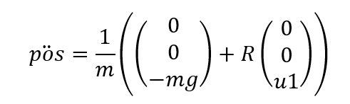
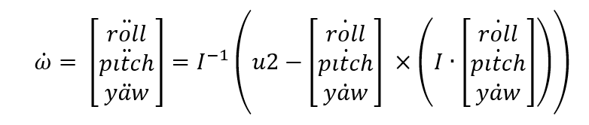
EOM takes U1 and U2 to evaluate State_dot.
Q

Slide 7
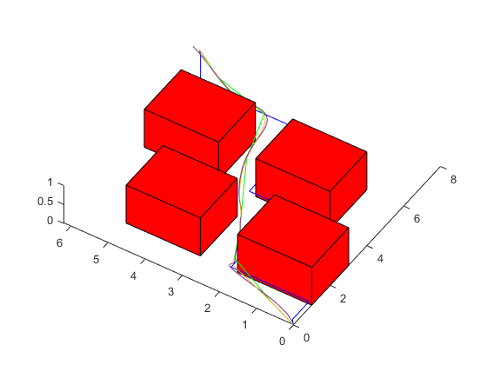
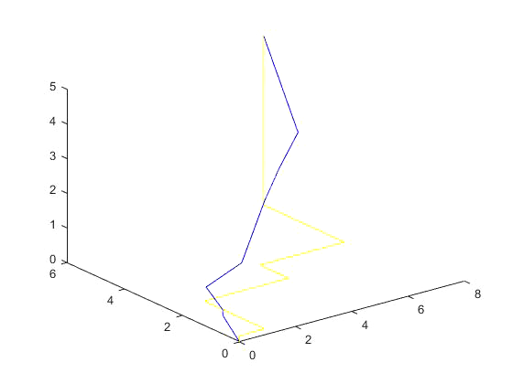
Results
theoretical shortest distance:11.05 our method: 11.24
Green: Shortest path
Yellow: Desired path
Purple: Actual path
Q

Slide 8
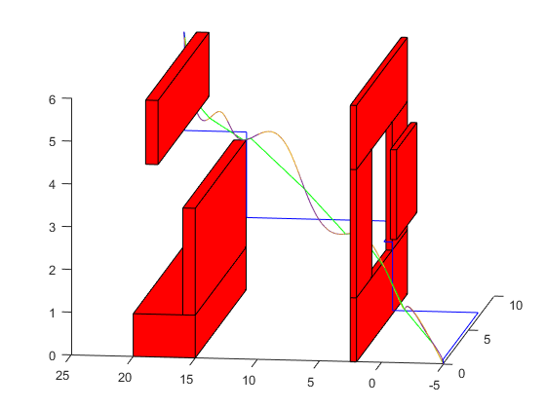
Results
theoretical shortest distance:27.59(directly from start point to goal) our method: 28.44
Green: Shortest path
Yellow: Desired path
Purple: Actual path
Q

Slide 9
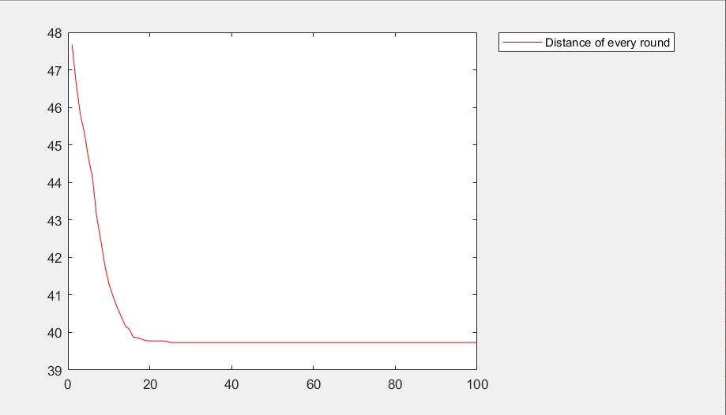
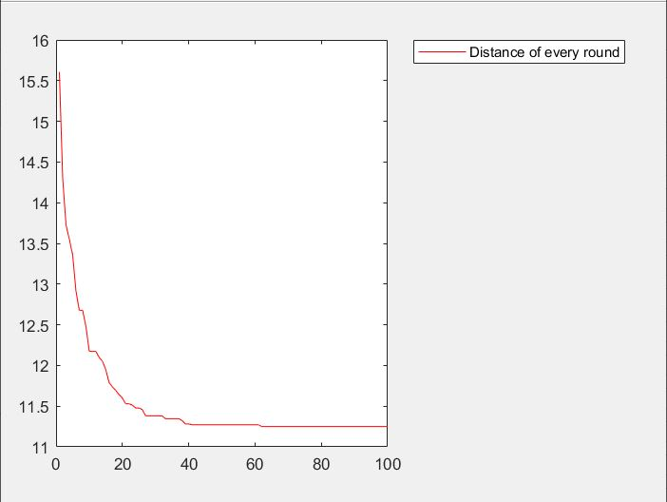
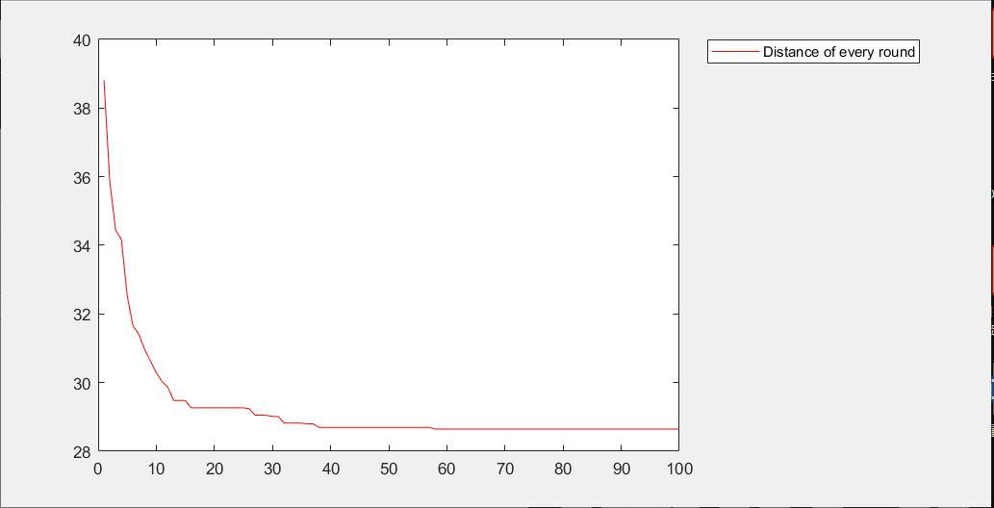
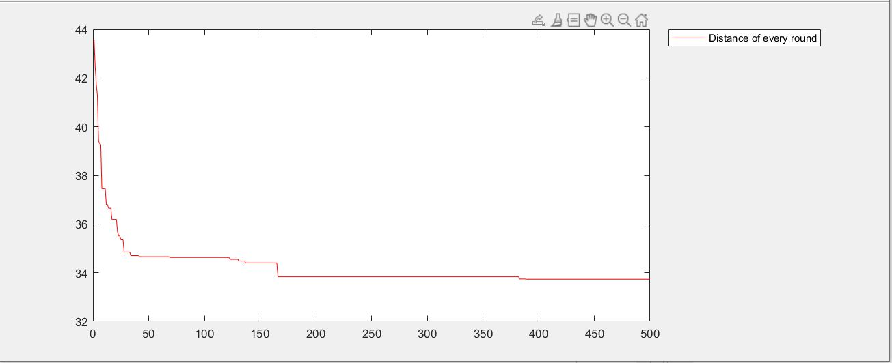
Results
Plots of Total Distance in each CEM iteration
map0
map1
map2
map3
Q

Slide 10
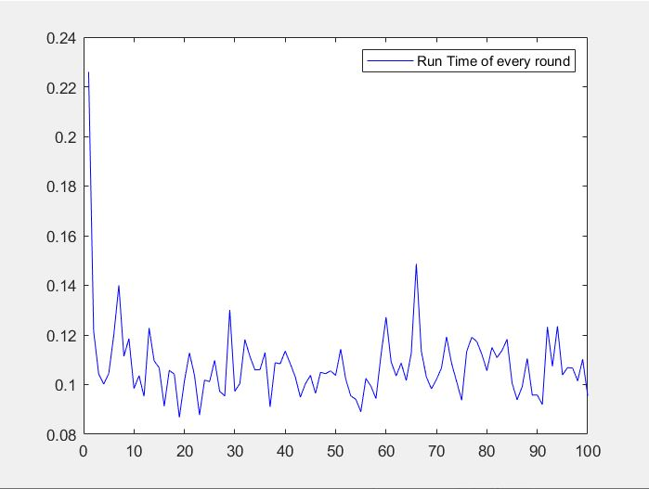
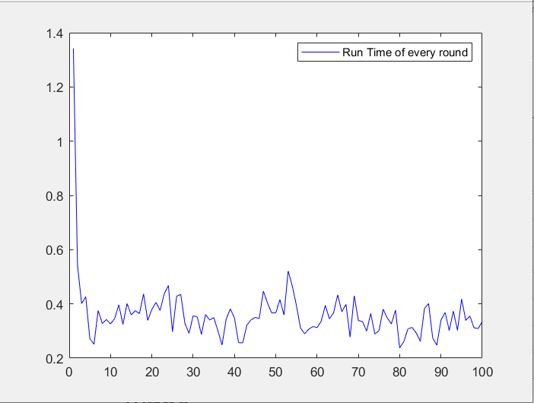
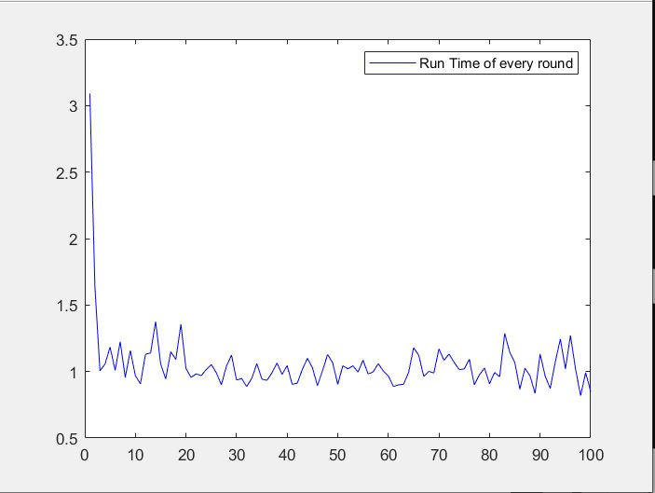
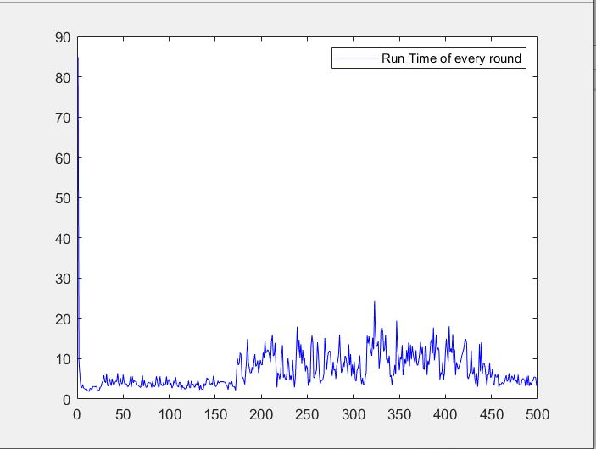
Results
Plots of Run Time in each CEM iteration
map0
map1
map2
map3

Slide 11
Questions?
Model
Trajectory generation
Controller
Equation of Motion
Results

Slide 12
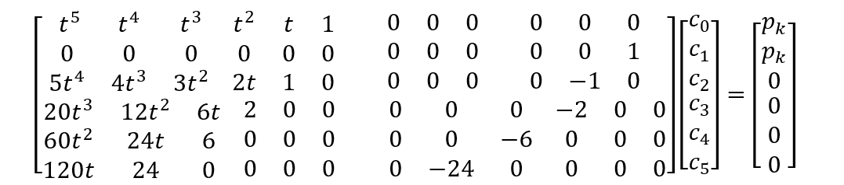
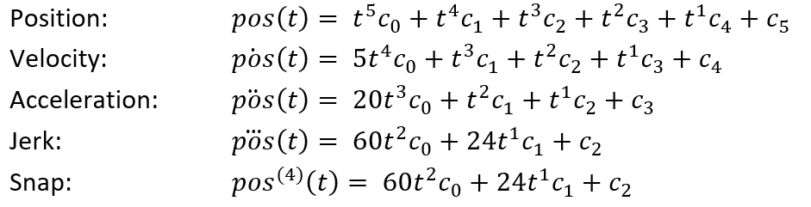
We used minimum jerk segments methods to generate the trajectory.
Segment k at pk
Segment k+1 at pk
Q

Slide 13
Reference
https://alliance.seas.upenn.edu/~meam620/wiki/index.php?n=Main.Schedule

